Slide 1

Two-dimensional random variable
By Prof. Foram Rajdev

Slide 2
Joint Probability Distribution
There are many experiments where we have to observe two random variables simultaneously in order to determine not only their individual behaviour but also the degree of relationship between them. For example, X : Age ; Y : Blood pressure of a person
Let X and Y be two discrete random variables defined on the same sample space S. Then the joint probability of mass function of two discrete random variables X and Y is a function f(x,y) defined on the product of Set
Assigning probability to each of the ordered pairs
, where X can assume any one of m-values and Y can assume any one of n-values

Slide 3
Thus , gives the probability for the simultaneous occurrences of the outcomes x_{i} and y_{j}
Further, f(x,y) satisfies the following.
The set of triplets for i=1,2,….m ; j=1,2,…,n, is known as the joint probability distribution of X and Y.

Slide 4
The following table shows representation of joint probability distributions.
 | y₁ | y₂ | y₃ | ….. | y_{n} | Row sums
x₁ | f(x₁,y₁) | f(x₁,y₂) | f(x₁,y₃) | …. | f(x₁,y_{n}) | f(x₁)
x₂ | f(x₂,y₁) | f(x₂,y₂) | f(x₂,y₃) | ….. | f(x₂,y_{n}) | f(x₂ )
x₃ | f(x₃,y₁) | f(x₃,y₂) | f(x₃,y₃) | …. | f(x₃,y_{n}) | f(x₃)
: : | : : | : : | : : | …. | : :
x_{m} | f(x_{m},y₁) | f(x_{m},y₂) | f(x_{m},y₃) | …. | f(x_{m},y_{n}) | f(x_{m})
Column sums | g(y₁ ) | g(y₁ ) | g(y₁ ) | ….. | g(y_{n} )

Slide 5
Marginal Distribution
Marginal distribution f(x) of X is given by
Similarly, marginal distribution g(y) of Y is given by

Slide 6


Example: Find the marginal function of the following:

Slide 8


Slide 9
Conditional Probability
This is called conditional probability function of X when
This is called conditional probability function of Y when

Slide 10
Example:32
Example: :
From the table, find
Y / X | 1 | 2 | 3
1 | 2/21 | 3/21 | 4/21
2 | 3/21 | 4/21 | 5/21

Slide 11
Solution:

Slide 14
Example
For the following probability distribution of X and Y find :
(i)
(ii)
(iii)
X Y-> | 1 | 2 | 3 | 4 | 5 | 6
0 | 0 | 0 | 1/32 | 2/32 | 2/32 | 3/32
1 | 1/16 | 1/16 | 1/8 | 1/8 | 1/8 | 1/8
2 | 1/32 | 1/32 | 1/64 | 1/64 | 0 | 2/64

Slide 15
Solution
X Y-> | 1 | 2 | 3 | 4 | 5 | 6
0 | 0 | 0 | 1/32 | 2/32 | 2/32 | 3/32 | 8/32
1 | 1/16 | 1/16 | 1/8 | 1/8 | 1/8 | 1/8 | 10/16
2 | 1/32 | 1/32 | 1/64 | 1/64 | 0 | 2/64 | 8/64
 | 3/32 | 3/32 | 11/64 | 13/64 | 6/32 | 16/64 | 1

Slide 17
Network Traffic Analysis An ICT engineering student is analyzing network traffic in a university's computer science department. They have collected data on the types of network protocols (TCP, UDP) used by students and staff, as well as the time of day when the network activity occurs. The student recorded the following joint probabilities in a table:
Protocol/Time of Day | Morning | Afternoon | Evening
TCP | 0.25 | 0.30 | 0.15
UDP | 0.15 | 0.20 | 0.15
The student wants to analyze the marginal distribution of network protocols and the conditional distribution of protocols given the time of day.
Question:
Calculate the marginal distribution of network protocols (TCP and UDP).
Determine the conditional distribution of network protocols given the time of day (morning, afternoon, and evening).

Slide 18
Marginal Distribution of Network Protocols:
Marginal distribution of TCP: P(TCP) = P(TCP, Morning) + P(TCP, Afternoon) + P(TCP, Evening)
=
Marginal distribution of UDP: P(UDP) = P(UDP, Morning) + P(UDP, Afternoon) + P(UDP, Evening)
=
Conditional Distribution of Network Protocols Given Time of Day:
Given Morning:
P(TCP|Morning) = P(TCP, Morning) / P(Morning)
P(UDP|Morning) = P(UDP, Morning) / P(Morning)
Given Afternoon:
P(TCP|Afternoon) = P(TCP, Afternoon) / P(Afternoon)
P(UDP|Afternoon) = P(UDP, Afternoon) / P(Afternoon)
Given Evening:
P(TCP|Evening) = P(TCP, Evening) / P(Evening) =
P(UDP|Evening) = P(UDP, Evening) / P(Evening) =

Slide 19
Independent Variables
Two random variables X and Y are said to be independent if ,

Slide 20
Expectation
Let (X,Y) be two dimensional discrete random variable with joint discrete density function
The expectation is defined as,

Slide 21
Covariance
Let X and Y be two random variables. The covariance of X and Y is defined as,
Correlation coefficient
The correlation coefficient of two random variables X and Y is defined as,
where Note:

Slide 22
Example
Let X and Y have joint p.d.f.
Find marginal distribution of X and Y. Also find conditional distribution of X given Y=1
Y X | -1 | 0 | 1
0 | b | 2b | b
1 | 3b | 2b | b
2 | 2b | b | 2b

Slide 23
Marginal distribution of X ;
P(X=-1) =6b, P(X=0) = 5b, P(X=1)=4b
Marginal distribution of Y ;
P(Y=0) = 4b, P(Y=1)=6b, P(Y=2)=5b
Y X | -1 | 0 | 1
0 | b | 2b | b | 4b
1 | 3b | 2b | b | 6b
2 | 2b | b | 2b | 5b
 | 6b | 5b | 4b | 15b

Slide 24
Conditional distribution of X when Y=1

Slide 25
Example
The joint probability distribution of X and Y is given in the following table.
(a)Find the marginal probability distribution of Y.
(b) Find the conditional distribution of Y given X=4.
(c ) Find Covariance of X and Y
(d) Are X and Y independent?
X Y | 1 | 3 | 9
2 | 1/8 | 1/24 | 1/12
4 | 1/4 | 1/4 | 0
6 | 1/8 | 1/24 | 1/12

Slide 26
solution
(a) Marginal probability distribution of Y
X Y | 1 | 3 | 9 | Row Sum
2 | 1/8 | 1/24 | 1/12 | 6/24
4 | 1/4 | 1/4 | 0 | 2/4
6 | 1/8 | 1/24 | 1/12 | 6/24
Column Sum | 4/8 | 8/24 | 2/12 | 1

Slide 27
(b) Conditional probability of Y when X=4,

Slide 28
To find Cov(X,Y) we will first find E(XY) , E(X), E(Y)

Slide 29
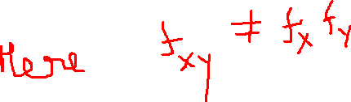

Slide 30
Correlation
Correlation measures the association between two (or more) variables and quantitates the strength of their relationship. It evaluates the existing data.
The relationship between the two variables may be linear or non linear. If the amount of change in one variable tends to bear a constant ratio to the amount of change in the other variable then correlation is said to be linear, otherwise it is called nonlinear.
The linear correlation is measured by coefficient of correlation ( r ), which measures their degree (strength) of linear relationship between two quantitative variables.

Slide 31
Correlation between two variables X & Y can be calculated by the following methods.
(1) Scatter diagram
(2) Karl Pearson’s method
(3) Spearman’s rank correlation method

Slide 32
Scatter Diagram
In this case the given statistical data is plotted as points on a rectangular cartesian coordinate system taking one independent variable ( say X ) along the horizontal axis while other dependent variable ( say Y ) along the vertical axis. Then we can interpret their nature and strength of correlation as in next slides.

Slide 33
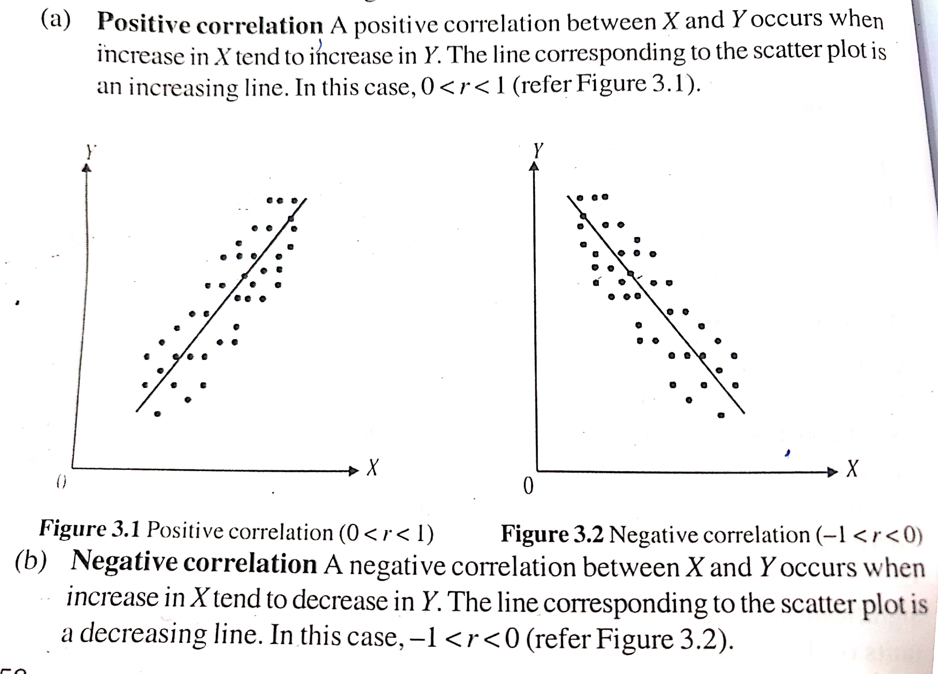
Positive &Negative Correlation

Slide 34
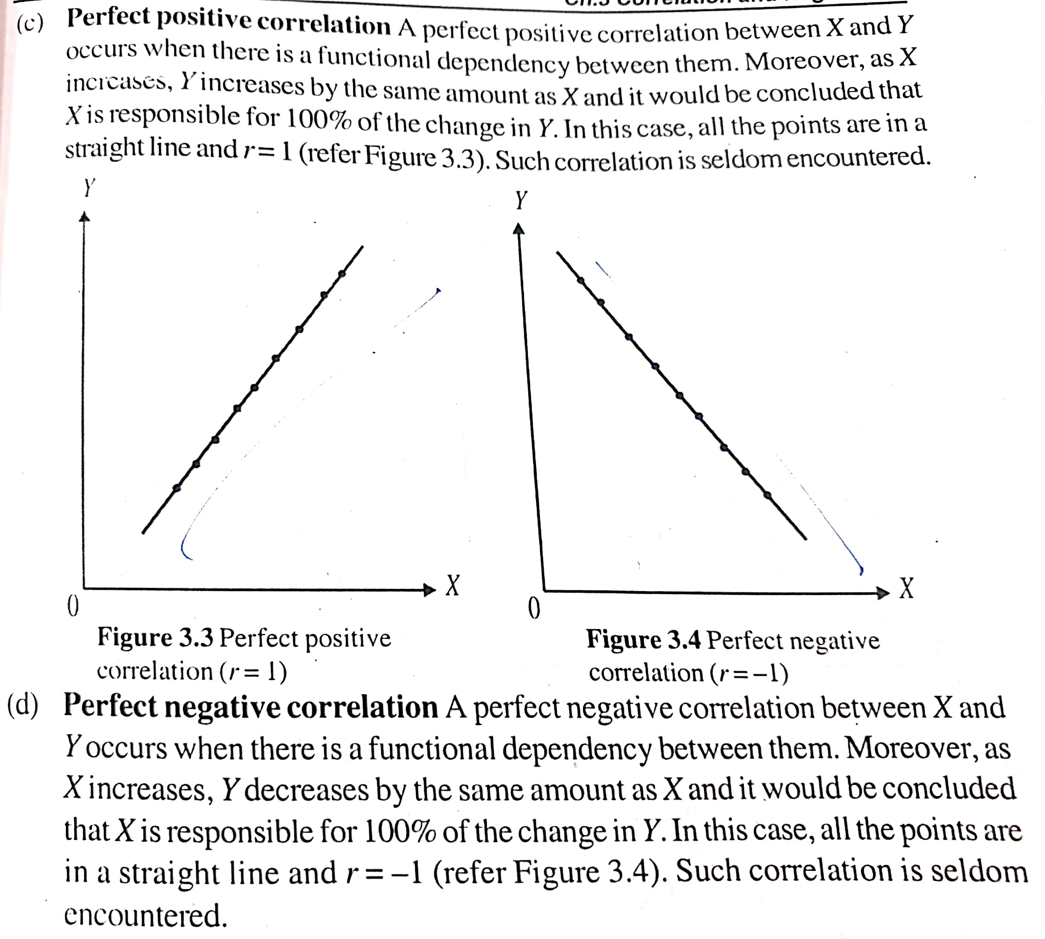
Perfect Positive and Perfect Negative Correlation

Slide 35
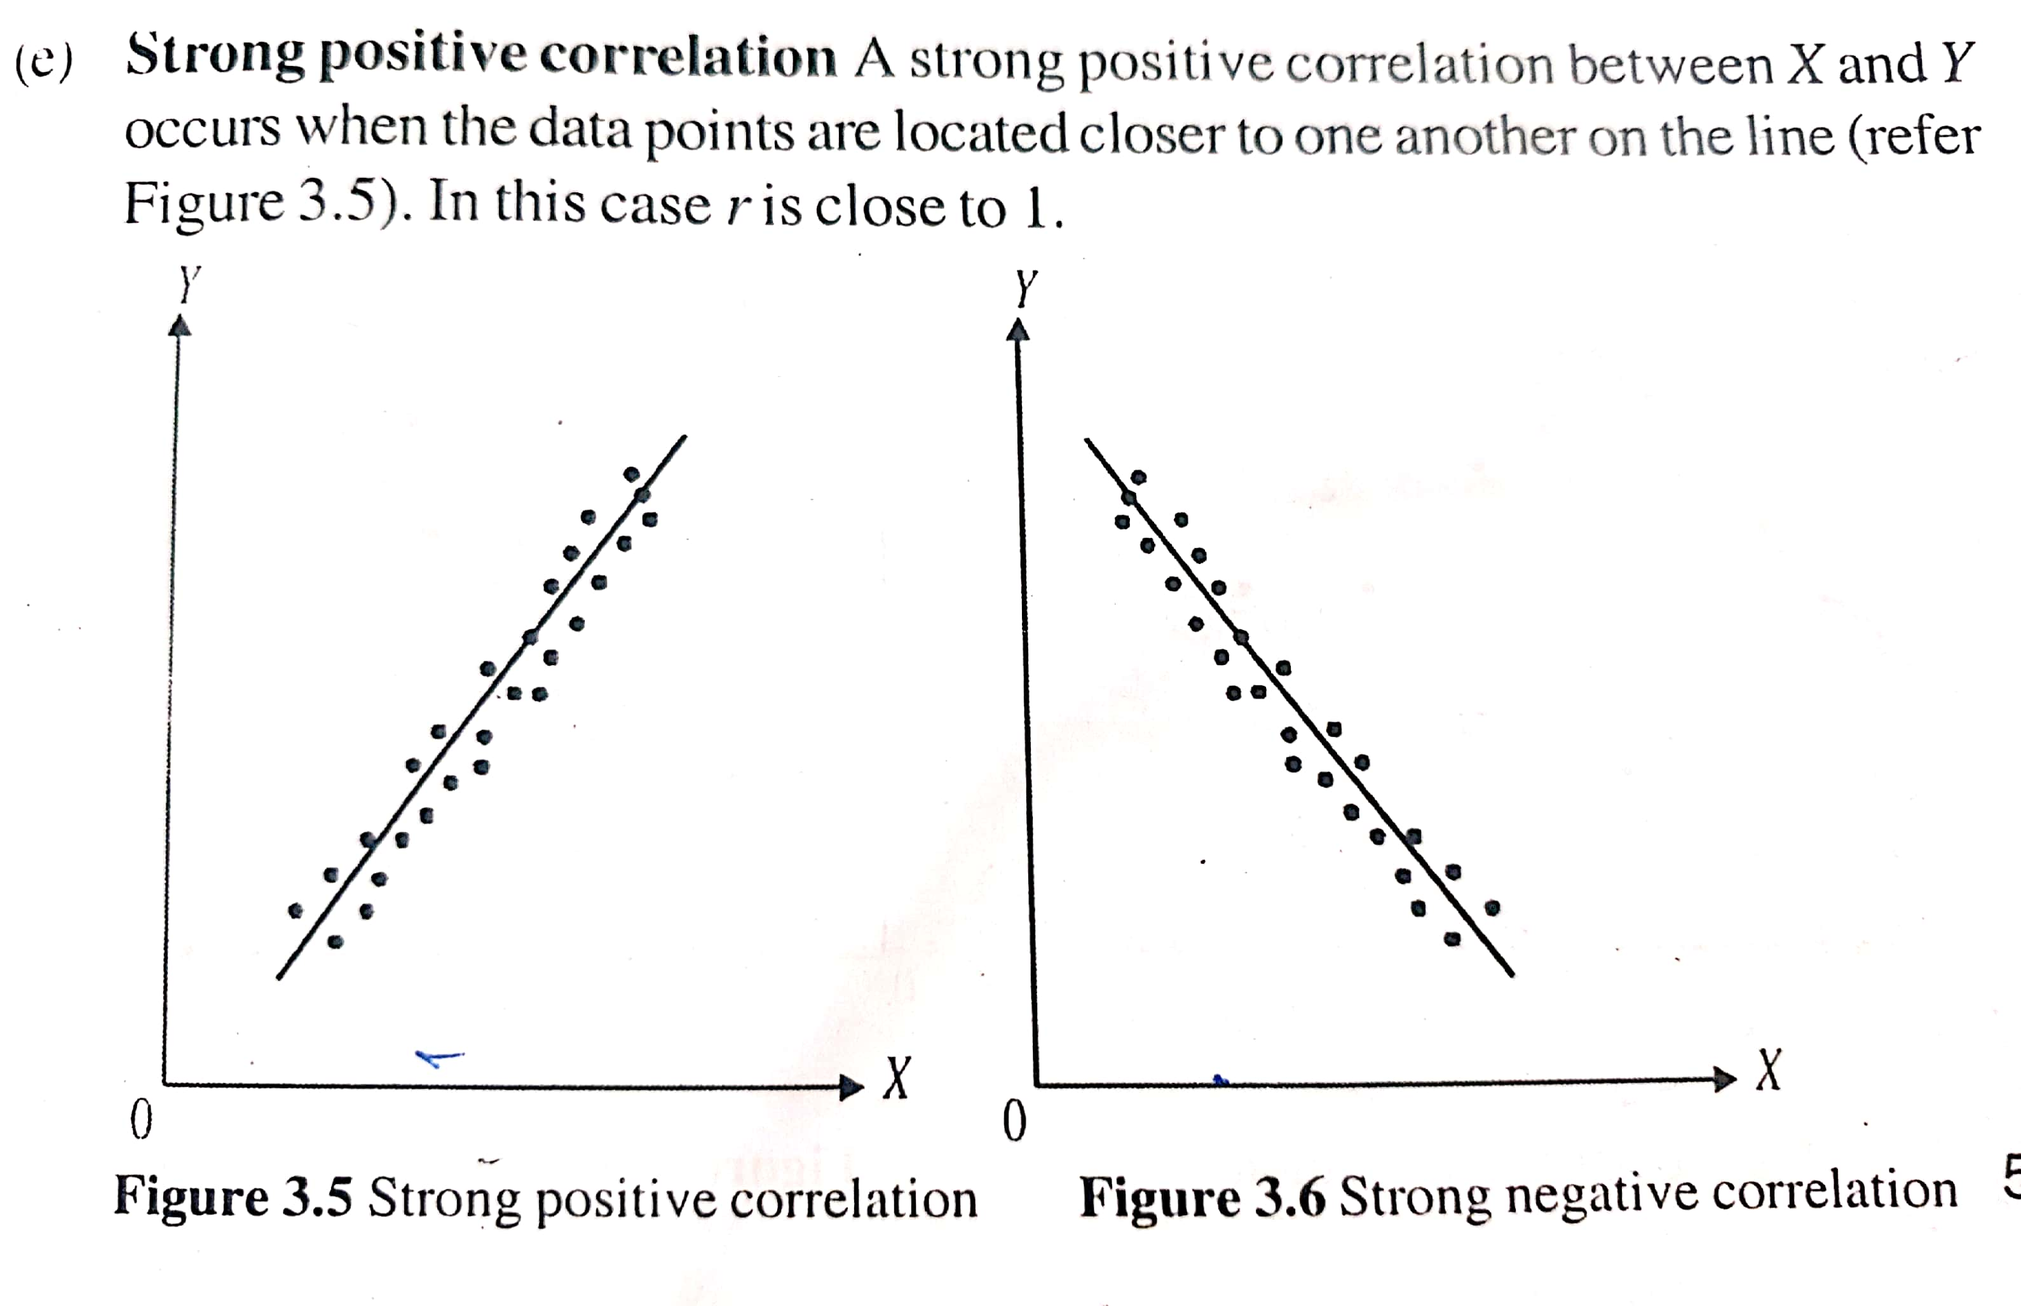
Strong Positive and Strong Negative Correlation

Slide 36
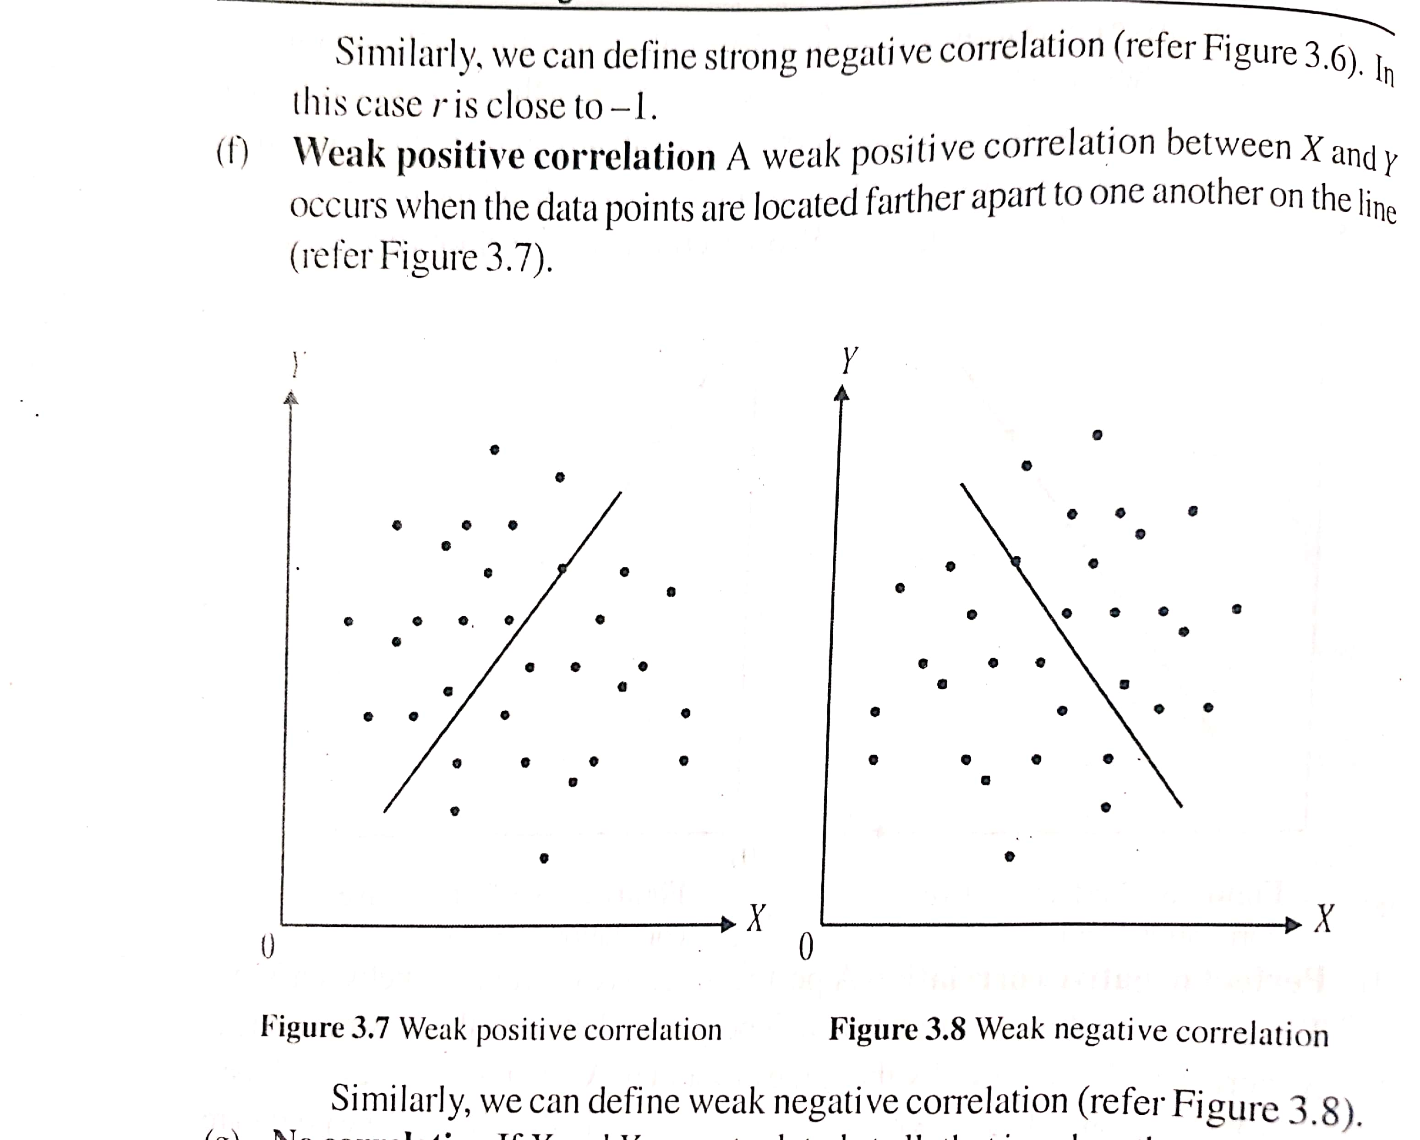
Weak Positive and Weak Negative Correlation

Slide 37
Positive Correlation : 0<r<1
Negative Correlation : -1<r<0
Perfect Positive Correlation : r=1
Perfect Negative : r=-1
Strong Positive Correlation : r close to 1
Strong Negative Correlation : r close to -1

Slide 38
Example
Question:
Suppose you are tasked with analyzing the relationship between
the number of users accessing a website and the server response time.
The following table represents the data collected over a period of time:
Number of Users (x) | Server Response Time (seconds) (y)
10 | 1.2
15 | 1.5
20 | 1.8
25 | 2.2
30 | 2.6
35 | 3.0
40 | 3.5
(a) Plot the data points on a scatter diagram with the number of users on the x-axis and the server response time on the y-axis.
(b) Based on the scatter diagram, describe the relationship between the number of users and the server response time.

Slide 39
Example
Plot the data points on a scatter diagram with the number of users on the x-axis and the server response time on the y-axis.
(b) Based on the scatter diagram, there appears to be a strong positive correlation between the number of users and the server response time. As the number of users increases, the server response time also tends to increase.

Slide 40
Example
Suppose you are analyzing the relationship between the temperature (in degrees Celsius) and the number of ice creams sold at a beachside shop. The following table represents the data collected over a week:
Temperature (°C) | Ice Creams Sold
30 | 50
28 | 55
25 | 60
22 | 65
20 | 70
18 | 75
15 | 80
Plot the data points on a scatter diagram with temperature on the x-axis and the number of ice creams sold on the y-axis.
(b) Based on the scatter diagram, describe the relationship between temperature and the number of ice creams sold.

Slide 41
Example
Plot the data points on a scatter diagram with temperature on the x-axis and the number of ice creams sold on the y-axis.
(b) Based on the scatter diagram, there appears to be a strong negative correlation between the temperature and the number of ice creams sold. As the temperature decreases, the number of ice creams sold tends to slightly increase.

Slide 42
Karl Pearson’s Method
If are n – pair of observations on 2 variables X and Y, then,

Slide 43
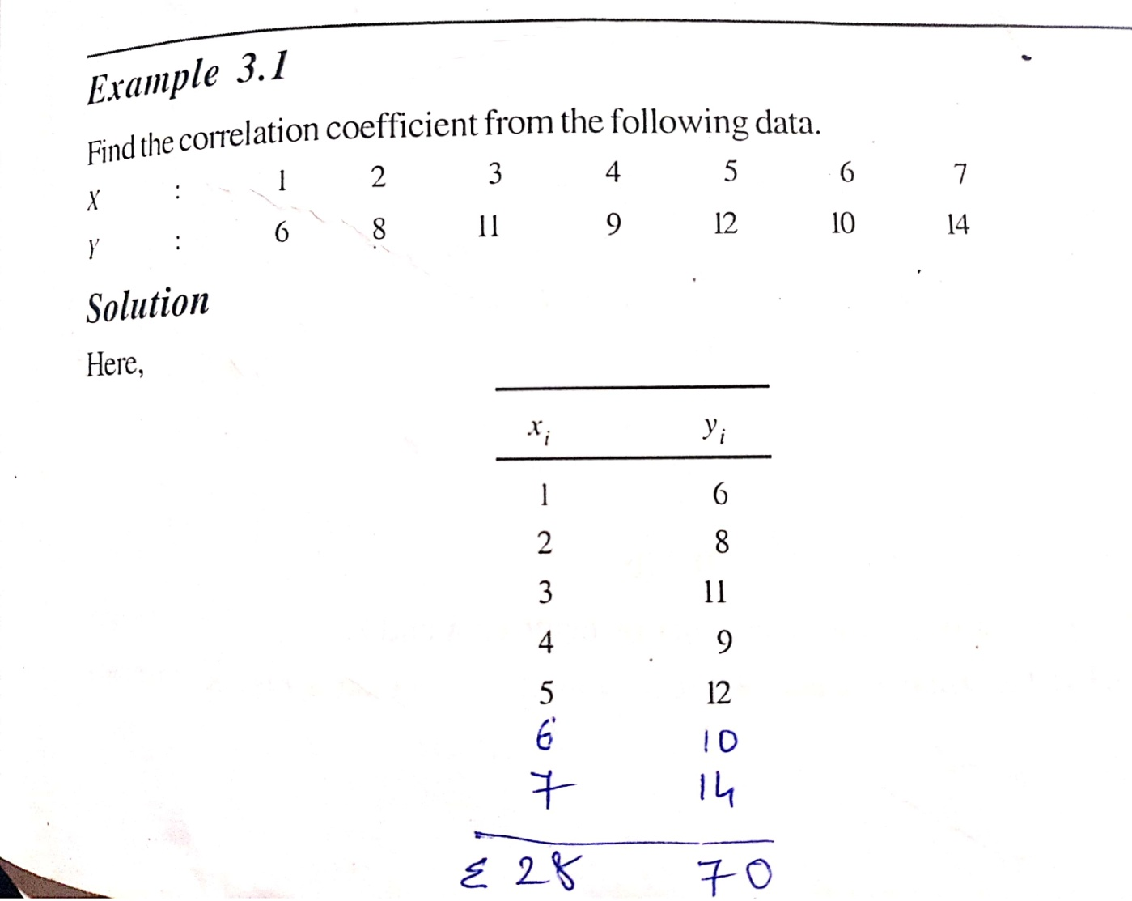
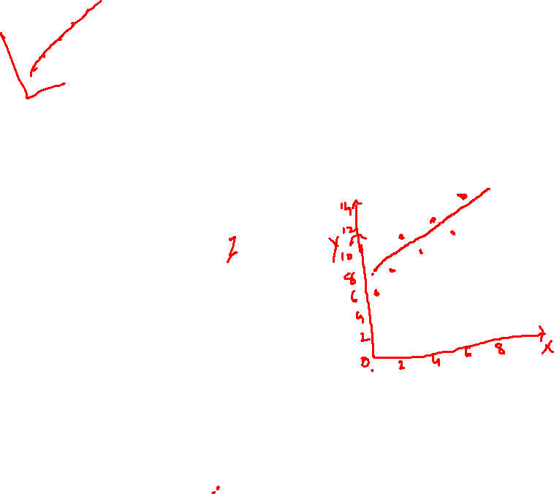

Slide 44
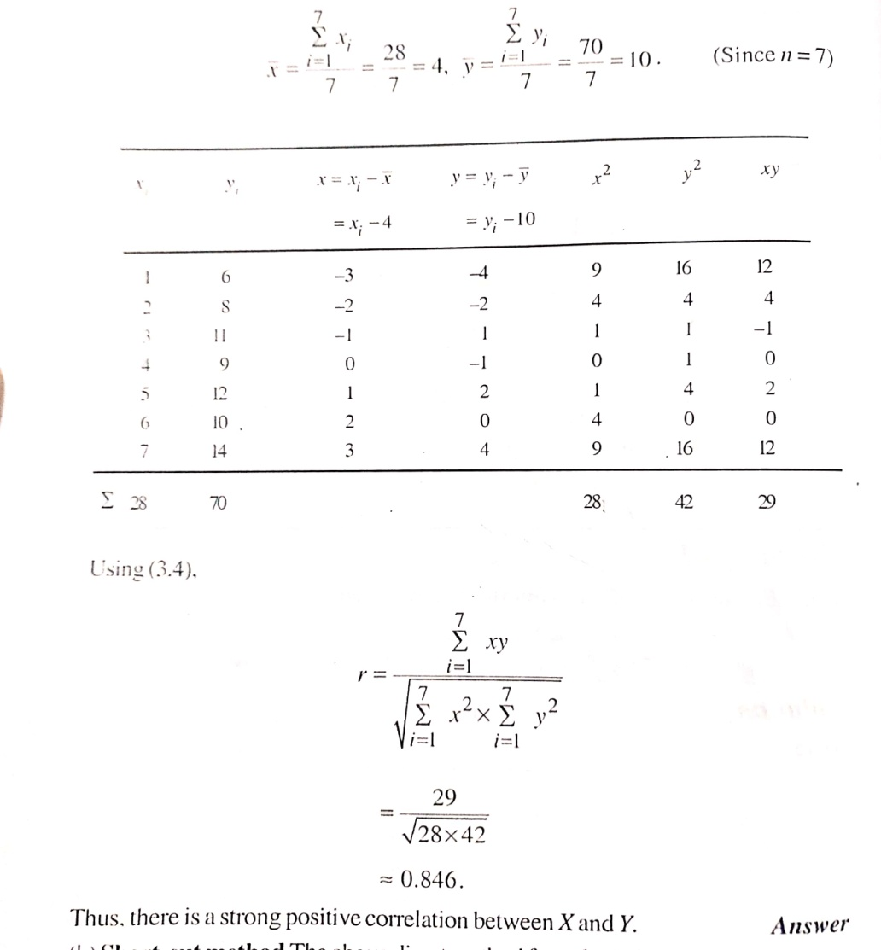

Slide 45
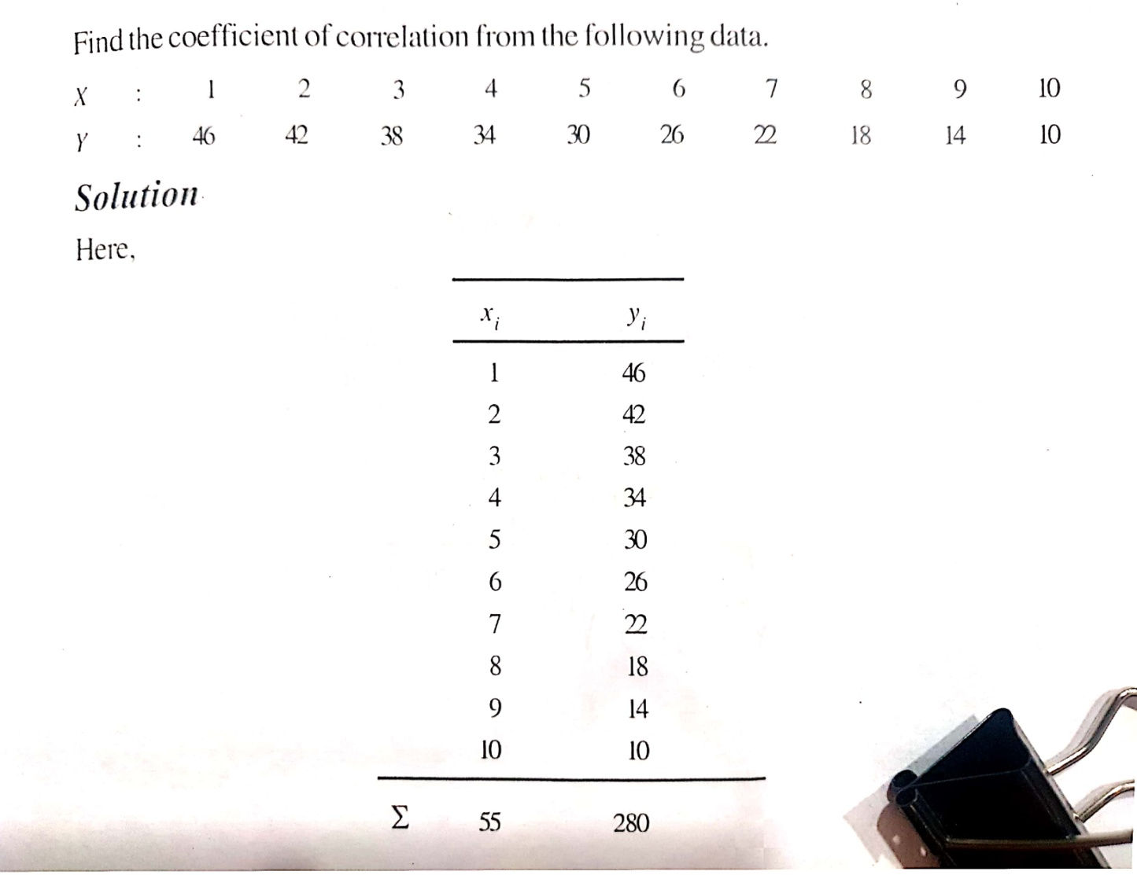

Slide 46
Spearman’s Rank Correlation Method
Rank Correlation method is based on the rank or the order of the variables and not the magnitude of the variables. Here, the individuals are arranged in order of proficiency. If the ranks are assigned to the individuals range from 1 to n, then the correlation coefficient between two series of ranks is called rank correlation coefficient. Spearman’s formula for rank coefficient of correlation is given by,
where d is the difference between the ranks of the two series and n is the number of individuals in each series.

Slide 47
Example
Calculate the rank correlation coefficient, if two judges in a beauty contest ranked the entries as follows.
Judge X | 1 | 2 | 3 | 4 | 5
Judge Y | 5 | 4 | 3 | 2 | 1

Slide 48
Solution
X (Rank R₁⁾ | Y(Rank R₂⁾ | _{d= R1-R2} | d²
1 | 5 | -4 | 16
2 | 4 | -2 | 4
3 | 3 | 0 | 0
4 | 2 | 2 | 4
5 | 1 | 4 | 16

Slide 49
Example
Ten students got the following percentage of marks in mathematics and statistics.
Calculate the rank correlation coefficient.
Student roll no | 1 | 2 | 3 | 4 | 5 | 6 | 7 | 8 | 9 | 10
Maths Marks | 78 | 36 | 98 | 25 | 75 | 82 | 90 | 62 | 65 | 39
Statistics Marks | 84 | 51 | 91 | 60 | 68 | 62 | 86 | 58 | 53 | 47

Slide 50
Solution
 | Maths |  | Statistics
Roll No | Marks | Rank R₁ | Marks | Rank R₂ | d=R₁-R₂ | d²
1 | 78 | 4 | 84 | 3 | 1 | 1
2 | 36 | 9 | 51 | 9 | 0 | 0
3 | 98 | 1 | 91 | 1 | 0 | 0
4 | 25 | 10 | 60 | 6 | 4 | 16
5 | 75 | 5 | 68 | 4 | 1 | 1
6 | 82 | 3 | 62 | 5 | -2 | 4
7 | 90 | 2 | 86 | 2 | 0 | 0
8 | 62 | 7 | 58 | 7 | 0 | 0
9 | 65 | 6 | 53 | 8 | -2 | 4
10 | 39 | 8 | 47 | 10 | -2 | 4
 |  |  |  |  |  | ∑d²=30

Slide 52
H.W. que
In a College, IT Dept has arranged one competition for students to develop an efficient program to solve a problem. Ten students took part in the competition and ranked by two judges given in the following table. Find the degree of agreement between the two judges using rank correlation coefficient.
Judge 1 | 3 | 5 | 8 | 4 | 7 | 10 | 2 | 1 | 6 | 9
Judge 2 | 6 | 4 | 9 | 8 | 1 | 2 | 3 | 10 | 5 | 7

Slide 53
Regression
Regression means average relationship between two ( or more ) variables and this relationship is used to estimate (or predict) the most likely values of one variable for specified values of the other variable(s). Mathematically, regression uses the existing data to define a mathematical equation which can be used to estimate (or predict) the value of one variable based on the value of other variable. Thus, it can be used to predict the outcome of observations not previously seen or tested.
The regression line may be linear in which case the relationship between the variables fits a straight line, or nonlinear in which case a polynomial equation is fitted.

Slide 54
Regression Equation of Y on X
Let be the n-pair of observations on two variables X and Y and let the straight line to be fitted to these data is,
Y = a+bX
Then, the Regression equation of Y on X can be obtained by,

Slide 55
Regression Equation of X on Y
The Regression equation of X on Y can be obtained by,

Slide 56
Note: The numbers b_{yx ,} b_{xy} are called regression coefficients of the two regression lines which we obtained .
The relation between Correlation coefficient and regression coefficients is ,

Slide 57
Example
The scores of 12 students in their Mathematics(X) and Statistics (Y) classes are as below.
Find Regression line of Y on X.
Math(X) | 2 | 3 | 4 | 4 | 5 | 6 | 6 | 7 | 7 | 8 | 10 | 10
Statistics(Y) | 1 | 3 | 2 | 4 | 4 | 4 | 6 | 4 | 6 | 7 | 9 | 10

Slide 58
x_{i} | y_{i} | X_{i}² | X_{i} y_{i}
2 | 1 | 4 | 2
3 | 3 | 9 | 9
4 | 2 | 16 | 8
4 | 4 | 16 | 16
5 | 4 | 25 | 20
6 | 4 | 36 | 24
6 | 6 | 36 | 36
7 | 4 | 49 | 28
7 | 6 | 49 | 42
8 | 7 | 64 | 56
10 | 9 | 100 | 90
10 | 10 | 100 | 100

Slide 59
From table,

Slide 60
Hence, the required regression line of Y on X is,

Slide 61
que 2
A study of the amount of rainfall and the quantity of air pollution removed produced the following data.
(a) Find the equation of the regression line to predict the particulate removed from the amount of daily rainfall.
(b) Find the amount of particulate removed when daily rainfall is x=4.8 units.
Daily Rainfall x (cm) | 4.3 | 4.5 | 5.9 | 5.6 | 6.1 | 5.2 | 3.8 | 2.1 | 7.5
Particulate Removed y(units) | 126 | 121 | 116 | 118 | 114 | 118 | 132 | 141 | 108

Slide 62
que 3
From the following data, obtain the two regression lines and the correlation coefficient.
x | 100 | 98 | 78 | 85 | 110 | 93 | 80
y | 85 | 90 | 70 | 72 | 95 | 81 | 74

